Slide 1
Gilad Lab Meeting
Ittai Eres
2 August 2017

Slide 2
Background: The 3D Genome
~2 meters of DNA packed into each micrometer-scale nucleus
Folding brings linearly distant loci into proximity
Many different levels at which DNA is compartmentalized
Fraser et al. 2015
Notes:
DNA compartmentalization levels:
DNA wrapped around histone octamers in complex w/ other proteins to form chromatin; shortens chromosomes ~7-fold
Most basic level of packaging, PTMs to histones alter chromatin state & thus DNA accessibility
Beyond this level, we know of the higher-order structure, but it is largely poorly characterized (due to relatively recent discovery)
Identification of “topologically associated domains”, TADs, w/ median size of 880 kb
Elements w/in TADs interact more frequently with other elements in the TAD than w/ neighboring regions
Initial ID showed highly conserved—across human, mouse, and drosophila
Sub-TADs, domains w/in them that associate, still very poorly characterized and likely to be some of most interesting interaxns (scale greater than linear proximity, but less than a whole Mb). Putatively what varies more b/t tissues & b/t species—larger order structures need to be more conserved
Have also ID’d two types of larger-scale chromosome compartments:
Open “A” compartments: more like euchromatin, high GC content, enriched for genes, txn activity, Dnase I hypersnesitivity, and histone marks assoc. w/ active/poised chromatin (H3K36me3 & H3K27me3, respectively)
Closed “B” compartments: more like heterochromatin, high levels of silencing histone marks (e.g. H3K9me3)
Chromosome territories: where in the nucleus individual chromosomes tend to be
Ultimately, question really comes down to: which loci are coming into contact? Which enhancers and other CREs act on which promoters (or other elements)? To get at this, need to better characterize sub-TAD domains and structure—w/ tech of Hi-C!

Slide 3
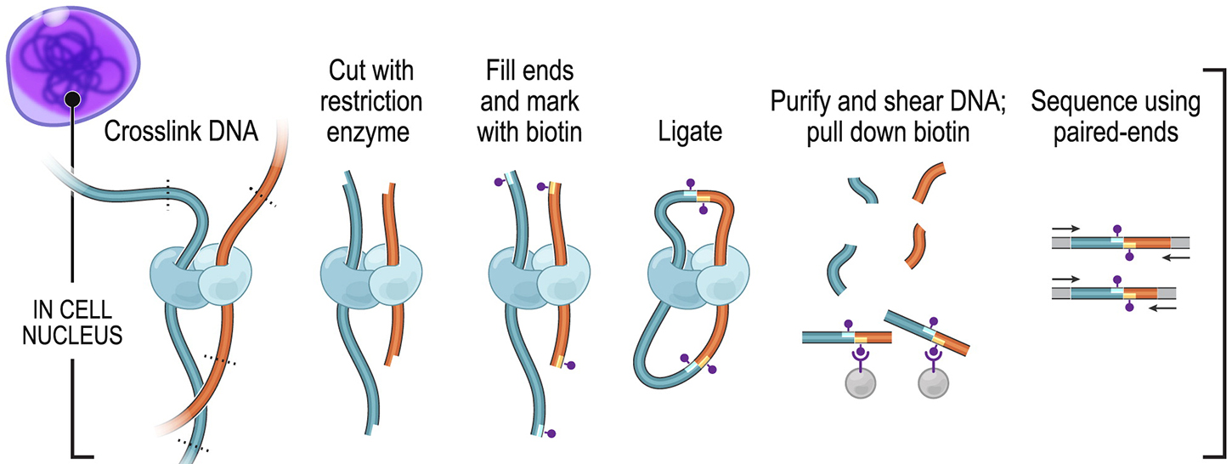
Hi-C
Rao et al. 2014
GATCGATC
Ligation junction
Notes:
Hi-C is latest advancement in suite of chromosome conformation capture technologies—which do exactly what they sound like, capture the conformation of chromosomes
Earlier techniques (3C in 2002) allowed for assaying contact between two individual loci.
Advancement to 4C (-on-chip) then gave one locus’ contacts genome-wide
5C (carbon copy) allowed for detecting all interactions b/t loci within a certain region, typically no larger than 1 Mb
Now, with Hi-C, we can look at all DNA-DNA contacts genome-wide. (Name: sick of coming up w/ C words and/or high-throughput sequencing?)
Don’t want/need to go into tons of detail, but briefly: (follow figure)
Very dirty, noise exp’t. Lots of unwanted products can be created in this process:
Contiguous sequences re-ligating
Self-ligation of the same restriction fragment, circularisation
And more!
This technique yields a highly complex library of chimeric di-tags (bottom), which you then PE sequence and map back to the genome in order to determine which loci are making contact!

Slide 4
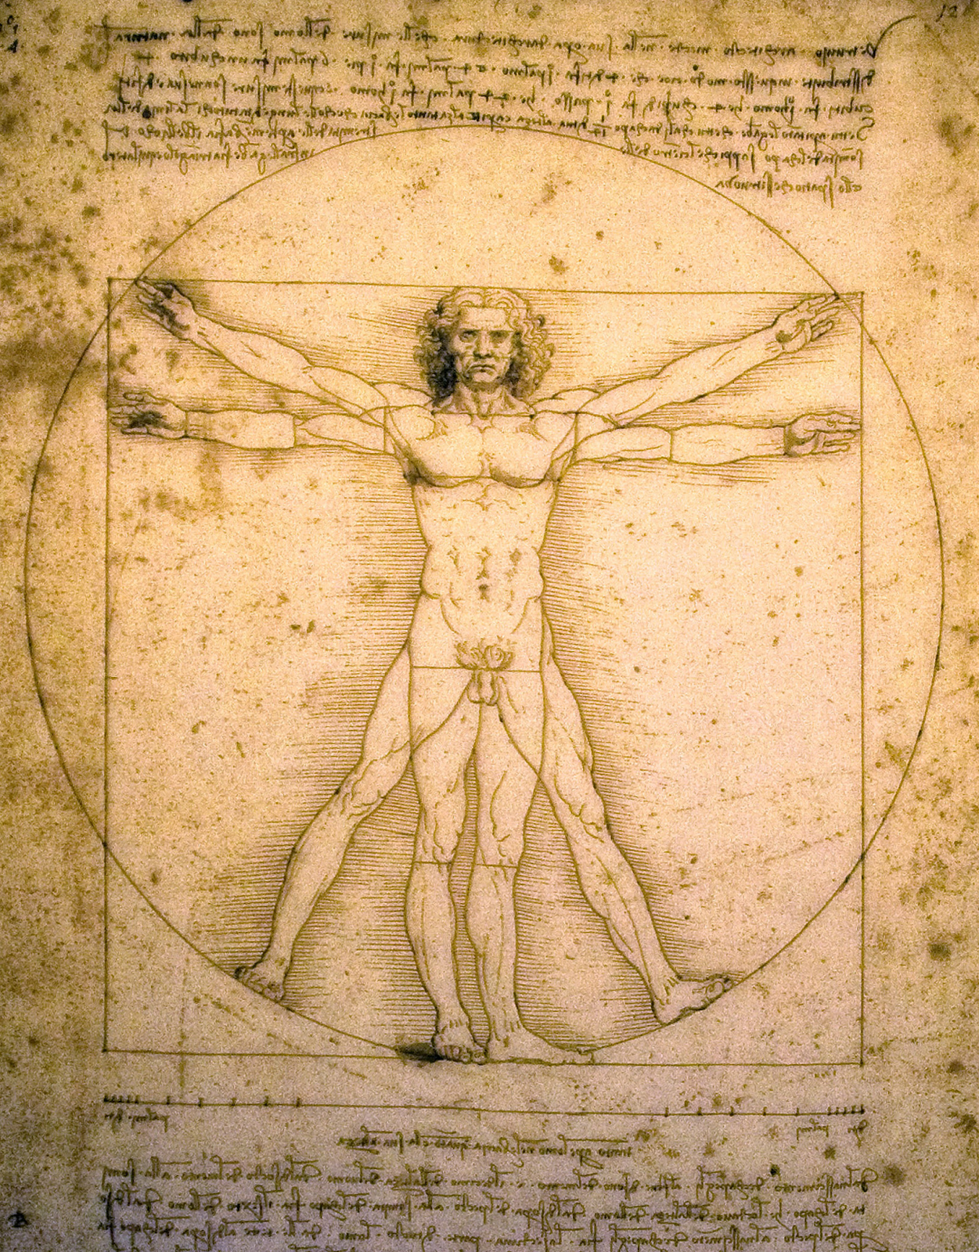
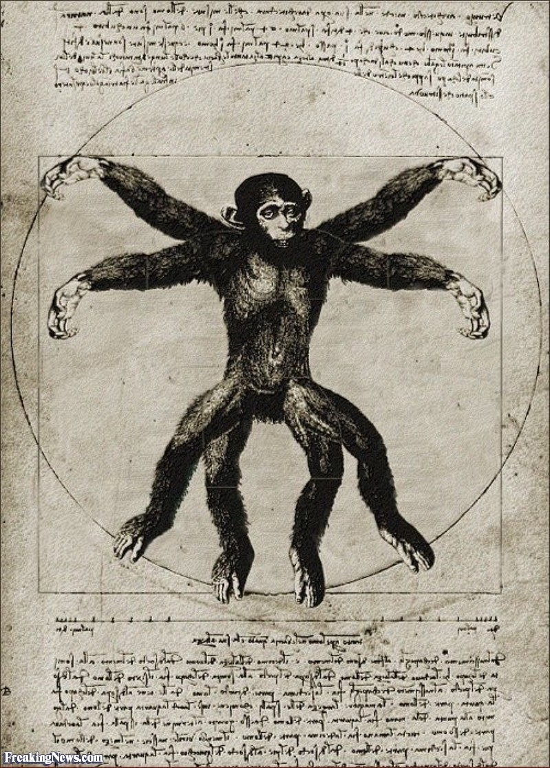
Data Collection
✓
x4, sex-balanced
x4, sex-balanced
Sigma-Aldrich
Notes:
So far, I’ve collected Hi-C data on 4 hiPSCs and 4 ciPSCs that we have in lab
If you’ve ever heard me talk about this before you know that the iPSC tech is one of the most exciting parts to me:
Ability to work with both humans and chimps, allowing evolutionary inference into noncoding diffs b/t the two
Different tissues differentiated from the same individuals
Minimizes confounding genetic variation (impt since that’s what “underlies the majority of identifiable regulatory differences in iPSCs”, Courtney and Nick paper [although that was actually about diffs in DNE methylation and gene expression vis a vis origin of iPSC vs genetic variation)
Allows for deeper understanding of the dynamics of development in regulating coordinated patterns of gene expression

Slide 5
General Pipeline
Run fastq files through HiCUP (mapping, filtering, preprocessing)
Use HiCUP summary files to create HOMER tag directories @ 25kb
Obtain list of significant Hi-C hits for each individual w/ HOMER
Run significant hits through liftover for reciprocal best hits
Concatenate all significant hits together
Overlap ortho. data on significant hits (TSS, TFBS, GWAS, eQTL, etc.)
Extract all individuals’ homer-normalized contact frequencies for significant hits
Pairwise cyclic loess norm. the data; linear modeling and analysis
Notes:
“significant Hi-C hits” is higher than expected contact frequency b/t the two bins
Expected is modeled w/ cumulative binomial dist’n
Liftover typically leaves me w/ about 60% of those hits back

Slide 6
Distributions and initial QC of Data
Human dist’ns Chimp dist’ns
Notes:
These data represent about 738k significant Hi-C hits!

Slide 7
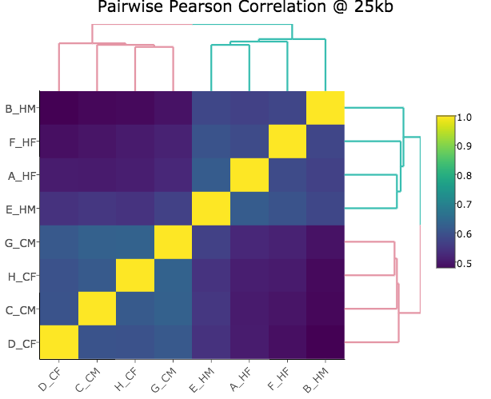
Clustering and PCA of Data
Notes:
This is clustering of full data (~738k hits), not TSS only which I’m about to show (~184k hits)

Slide 8
Linear Modeling Results
Y= β₀ + β_{sp}s + β_{sx}x + β_{btc}b + ε_{i}
Notes:
QQplot here looks pretty shitty, the black is first 50% of dist’n, blue is next 25%...
-Joyce offered I try running with batch as a random effect, this coming next!
-Humans coded as 1 and chimps as 0 in linear model, so volcano plot means that differential contacts appear enriched for DECREASE in contact frequency of humans
-Actual numbers for the significant betas in volcano plot
-Observing a large proportion of negative betas in chimp

Slide 9
Enrichment Analyses
Difference in Proportions p-val=0.9246
Difference in Proportions p-val=1.977 x 10⁻⁶
Difference in Proportions p-val=2.2 x 10⁻¹⁶
Significant hits appear to show:
Enrichment for TSS
Enrichment for TFBS as assayed by TF-chip at Encode
Depletion for highly conserved TFBS across species (human/mouse/rat alignment)
Nothing for eQTLs identified by Nick
Difference in Proportions p-val=1.675 x 10⁻⁶
Notes:
-Doing this on iPSC-specific eQTL from Nick’s work showed no serious difference with p-val~0.3, only had 280 or so eQTL to work with in first place so extremely small proportion of either group

Slide 10
QC After Shuffling Species Group Identity

Slide 11
Y= β₀ + β_{sp}s + β_{sx}x + β_{btc}b + ε_{i}
Notes:
Humans coded as 1 and chimps as 0 here, so seeing many significant hits where there is a marked DECREASE in human contact frequency as compared to chimp (rather than the reverse)
-Separating out linear models for different gene pairs by distance!
-Try this at few different resolutions and see if patterns are maintained!
-Concern right now that this is because of homer, things may be driven by how background is defined, etc.
-WTF is up with the human proportion on the left side of the BETA plots?
-Volcano plot #s: Reds on left represent
Reds on right represent

Slide 12
Notes:
Ones on top are cumulative starting from the bottom, ones on bottom are for discrete beta intervals
-It does appear majority of extreme observations (<=-7) are discovered exclusively in humans. The human discovered ones in the extreme negative end appear to be MUCH farther apart in distance than the chimp ortholog...(e.g. 46 million bp apart vs 175kb). They also ALL appear to be some nonsense on chr12 that is very close in humans and very far apart in chimps--chimps, chr12 21050000 & 67675000, humans, chr12 21000000 & 20850000…
-Major structure of bottom charts sensical
-Looking here at QC, learned that when we have an order of magnitude difference b/t the distances in pairs across the species, develop a rule for big distance differences
-Make these bottom plots again with numbers instead of proportions

Slide 15
Notes:
These plots show beta on the y axis and the mean of the Hi-C contact frequencies for the given species on the x axis
Since the contact frequencies are already log2 ratios of obs/expected, this means the betas for species represent the log ratio of their difference—right?

Slide 16
Liftover Bin Dropouts
Notes:
-Some kind of statistical test for checking the groups against each other here, something like Fisher’s exact or something
-Vast majority of things that are dropping out are due to parts of the region being deleted or split in the other species

